Slide 1
Unit 5

Slide 2
Midpoint subdivision algorithm is an extension of the Cyrus Beck algorithm.
This algorithm is mainly used to compute visible areas of lines that are present in the view port are of the sector or the image.

Slide 3
It follows the principle of the bisection method and works similarly to the Cyrus Beck algorithm by bisecting the line in to equal halves.
But unlike the Cyrus Beck algorithm, which only bisects the line once, Midpoint Subdivision Algorithm bisects the line numerous times.

Slide 4
Also the Sutherland Cohen subdivision line clipping algorithm requires the calculation of the intersection of the line with the window edge.
These calculations can be avoided by repetitively subdividing the line at its midpoint.

Slide 5
Like other algorithm, initially the line is tested for visibility. If line is completely visible it is drawn and if it is completely invisible it is rejected.
If line is partially visible then it is subdivided in two equal parts.

Slide 6
The visibility tests are then applied to each half. This subdivision process is repeated until we get completely visible and completely invisible line segments.
This is illustrated in figure below

Slide 7
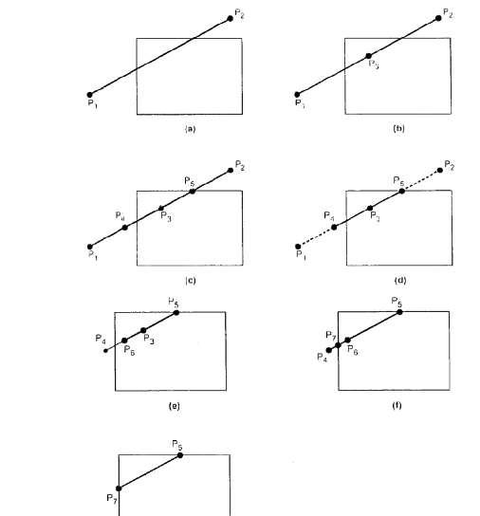

Slide 8
As shown in the figure , line P1 P2 is partially visible. It is subdivided in two equal Parts P1 P3 and P3 P2 (see Fig. (b)).
Both the line segments are tested for visibility and found to be partially visible.
Both line segments are then subdivided in two equal parts to get midpoints P4 and P5 (see Fig. (c)).
It is observed that line segments P1 P4 and P5 P2 are completely invisible and hence rejected.

Slide 9
However, line segment P3 P5 is completely visible and hence drawn. The remaining line segment P4 P3 is still partially visible.
It is then subdivided to get midpoint P6. It is observed that P6 P3 is completely visible whereas P4 P6 is partially visible.
Thus P6 P3 line segment is drawn and P4 P6 line segment is further subdivided into equal parts to get midpoint P7.
Now, it is observed that line segment P4 P7 is completely invisible and line segment P7 P6 is completely visible (see Fig. (f)), and there is no further partially visible segment.

Slide 10
ALGORITHM

Slide 11
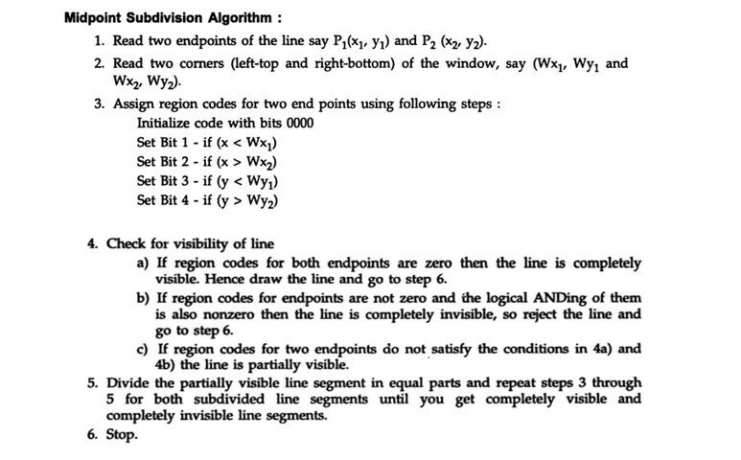

Slide 12
Video Ref links
https://youtu.be/lBdMeVvZ6Gc
https://youtu.be/PgU8IZlbgHg

